Slide 1
Introduction to Machine Learning

Slide 2
Origin
Arthur Samuel, an American pioneer in the field of computer gaming and artificial intelligence, coined the term "Machine Learning" in 1959 while at IBM.

Slide 3
Definition
Arthur Samuel (1959)
"Field of study that gives computers the ability to learn without being explicitly programmed"

Slide 4
Definition
1952 saw the first computer program which could learn as it ran. It was a game which played checkers, created by Arthur Samuel.
Had the program play 10000 games against itself
Work out which board positions were good and bad depending on wins/losses

Slide 5
Definition
Tom Michel (1998)
"A computer program is said to learn from experience E with respect to some class of tasks T and performance measure P, if its performance at tasks in T, as measured by P, improves with experience E”.

Slide 6
Definition
E = experience gained by the machine
P = Probability of next success
T=task to be performed
E.g. Email spam filtering

Slide 7
Example
Email spam filtering
T= mark email as spam
P = No of emails correctly marked spam
E = Watching user label email/not.

Slide 8
Applications
Database mining:
Machine learning has recently become so big party because of the huge amount of data being generated
Web data: (click-stream or click through data)
Medical records: Electronic records -> turn records in knowledges
Biological data: Gene sequences, ML algorithms give a better understanding of human genome
Engineering info: Data from sensors, log reports, photos etc.

Slide 9
Applications
Applications that we cannot program by hand
Autonomous helicopter
Handwriting recognition
This is very inexpensive because when you write an envelope, algorithms can automatically route envelopes through the post
Natural language processing (NLP)
AI pertaining to language
Computer vision
AI pertaining vision

Slide 10
Applications
Self customizing programs
Netflix
Amazon
iTunes genius
Take users info
Learn based on your behavior
Understand human learning and the brain
If we can build systems that mimic (or try to mimic) how the brain works, this may push our own understanding of the associated neurobiology

Slide 11
BIG DATA
Big data is any kind of data source that has at least one of four shared characteristics, called the four Vs:
» Extremely large Volumes of data
» The ability to move that data at a high Velocity of speed
» An ever-expanding Variety of data sources
» Veracity so that data sources truly represent truth
The accuracy of a machine learning model can increase substantially if it’s trained on big data.

Slide 12
DATA MINING
Data mining is the process of discovering patterns in large data sets involving methods at the intersection of machine learning, statistics, and database systems.

Slide 13
DATA SCIENTIST
Data scientists are big data wranglers, gathering and analyzing large sets of structured and unstructured data.
A data scientist’s role combines computer science, statistics, and mathematics.
They analyze, process, and model data then interpret the results to create plans for companies and other organizations.

Slide 14
AI
In computer science, artificial intelligence (AI), sometimes called machine intelligence, is intelligence demonstrated by machines, in contrast to the natural intelligence displayed by humans.
John McCarthy (September 4, 1927 – October 24, 2011) was an American computer scientist and cognitive scientist. McCarthy was one of the founders of the discipline of artificial intelligence. He coined the term "artificial intelligence" (AI).

Slide 15
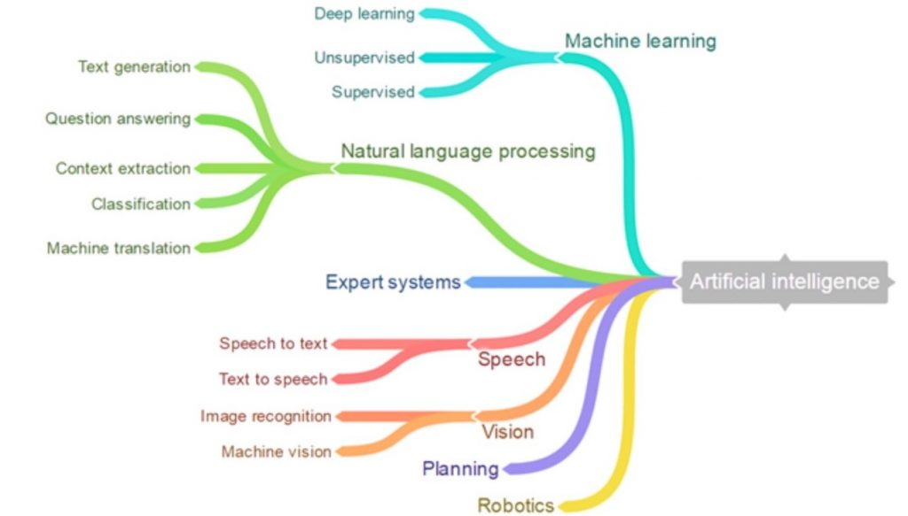

Slide 16
AI ?? ML ??
AI can be understood as the broadest way of describing systems that can “think.” For example, car AC that learn your preference or applications that can identify people and what they are doing in photos can be thought of as AI systems (Anything that mimics human behavior).
When we explore machine learning, we focus on the ability to learn and adapt a model based on the data rather than explicit programming
ML is a subset of AI.

Slide 17
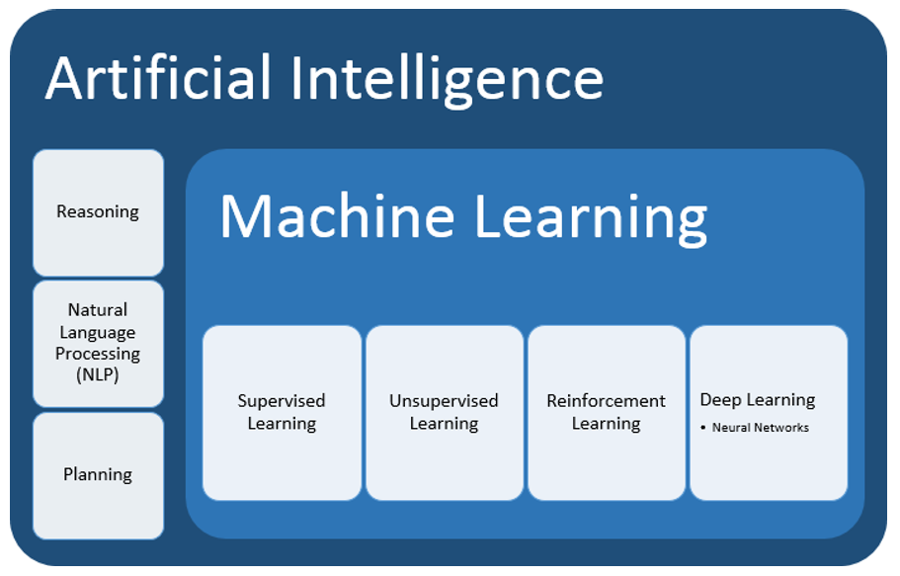

Slide 18
Supervised Learning
In supervised learning, we are given a data set and already know what our correct answer/output should look like for few dataset and we want to predict the output for some other input (whose answer we don’t know).
there is a relationship between the input and the output.
E.g. house pricing, tumor prediction, age prediction, etc.

Slide 19
Unsupervised Learning
Unsupervised learning allows us to approach problems with little or no idea what our results should look like.
segments data into groups of examples (clusters) or groups of features
Best suited when the problem requires a massive amount of data that is unlabeled
e.g. email spam-detecting, face-detection etc

Slide 20
Difference
Supervised :
Finds patterns (and develops predictive models) using both, input data and output data.
Unsupervised :
Finds patterns based only on input data. This technique is useful when you’re not quite sure what to look for. Often used for exploratory Analysis of raw data.

Slide 21
Reinforcement learning
Reinforcement learning
behavioral learning model.
The algorithm receives feedback from the analysis of the data so the user is guided to the best outcome.
Reinforcement learning differs from other types of supervised learning because the system isn’t trained with the sample data set. Rather, the system learns through trial and error. Therefore, a sequence of successful decisions will result in the process being “reinforced”.

Slide 22


Slide 23
Example
robotics or game playing
to train a robot to navigate a set of stairs
Game AI (e.g. PUBG, DOTA)
training a self-driving car

Slide 24
Neural networks and Deep learning
Deep learning is a machine learning technique that uses hierarchical neural networks to learn from a combination of unsupervised and supervised algorithms. Deep learning is often called a sub-discipline of machine learning.
Deep learning is especially useful when you’re trying to learn patterns from unstructured data

Slide 25
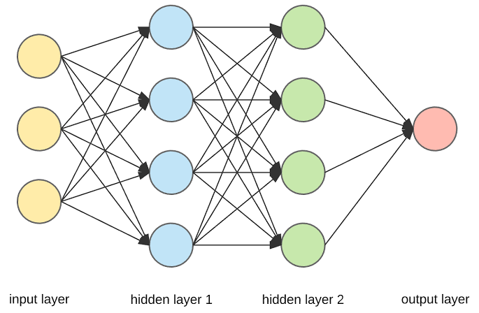

Slide 26
NLP
Natural Language Processing (NLP):
ability to train computers to understand both written text and human speech.
needed to capture the meaning of unstructured text from documents or communication from the user.
primary way that systems can interpret text and spoken language.
one of the fundamental technologies that allows non-technical people to interact with advanced technologies. For example, rather than needing to code, NLP can help users ask a system questions about complex data sets.

Slide 27

Kaggle
Kaggle allows users to find and publish data sets, explore and build models in a web-based data-science environment, work with other data scientists and machine learning engineers, and enter competitions to solve data science challenges.
Kaggle offers a no-setup, customizable, Jupyter Notebooks environment. Access free GPUs and a huge repository of community published data & code.

Slide 28

Jupyter Notebook
The Jupyter Notebook is an incredibly powerful tool for interactively developing and presenting data science projects.
Jupyter notebook is a very popular and flexible tool which lets us put our code, output of the code and any kind of visualization or plot etc. in the same document.
Basically it is a combination of an IDE, server to run your projects (called notebooks) either on your local computer or remotely, and has support for approximately 40 computer languages.
The notebooks are run/ interpreted via kernels, which seem like virtual machines and will use memory of the computer running it.

Slide 29

Google Colaboratory (Google Colabs)
Colaboratory allows you to use and share notebooks with others without having to download, install, or run anything on your own computer other than a browser.
Colab provides GPU and is totally free.
develop deep learning applications using popular libraries such as Keras, TensorFlow, PyTorch, and OpenCV.

Slide 30

Anaconda
Anaconda is the standard platform for Python data science, leading in open source innovation for machine learning.
It is a free and open-source distribution of the Python and R programming languages for scientific computing (data science, machine learning applications, large-scale data processing, predictive analytics, etc.), that aims to simplify package management and deployment.

Slide 31

Octave
GNU Octave is software featuring a high-level programming language, primarily intended for numerical computations.
Octave helps in solving linear and nonlinear problems numerically, and for performing other numerical experiments using a language that is mostly compatible with MATLAB.

